Slide 1

TA201T: Introduction to Manufacturing Processes I
2020-21 Semester I
Name: ANSHIT ARYA
Roll No.: 190158
Section : S - 1
Tutor: MIRTUNJAY KUMAR
Instructor: Dr. Anish Upadhyaya

Slide 2
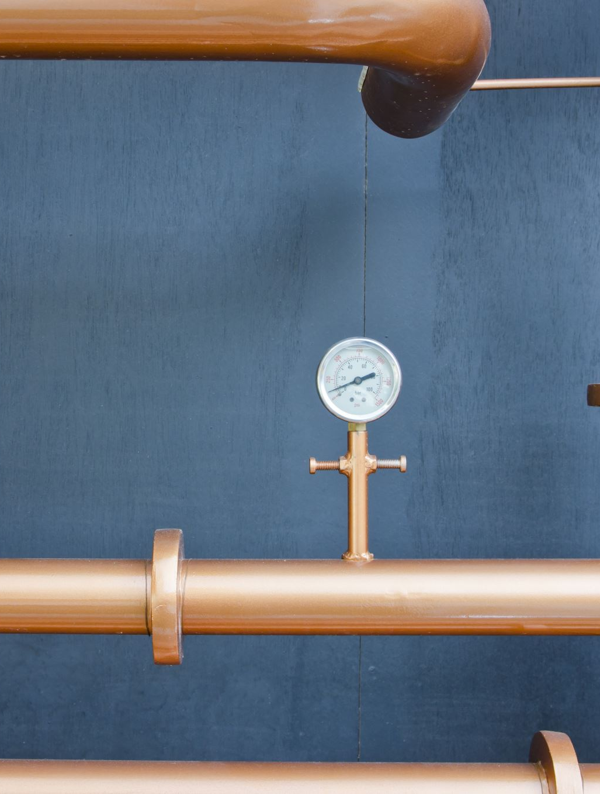
Stainless steel diving cylinder

Slide 3
outline
Diving Cylinder – An Introduction
History
Present times Diving cylinders
Steel composition
steel Manufacturing
Diving cylinder sectional view
Material components
Creating cylinders
Manufacturing cylindrical valves
Tanking up
Temperature change during filling (1/2)
Temperature change during filling (2/2)
references

Slide 4

Diving Cylinder – An Introduction
A diving cylinder is a cylinder usually used to transport and store high pressure gases usually oxygen.
There are different types of diving cylinder , they differ in materials used. Some are made up of stainless steel and others of aluminium .
Steel diving cylinders are heavy and are used for deep diving .

Slide 5
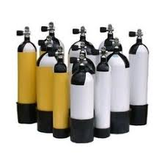
Literature review
In 1942, during the German occupation of France, Jacques-Yves Cousteau and emile Gagnan designed the first successful and safe open-circuit scuba, known as the Aqua-Lung.
Stainless Steel cylinders are manufactured from a process named “deep draw”.
Also the earliest attempt was made around 18th century by an Englishman john Lethbridge He built an underwater diving machine
The firs rebreather , was invented by Henry Fluess in 1879 .

Slide 6
Present times Diving cylinders
3 litre - are known as pony cylinders due to their very small size.
Aluminium - 5.7 litre scuba diving cylinders are used mostly in America and Caribbean as decompression tanks or rebreather tanks.
7 litre - these are also small and usually used for practice purposes. Main execution nowadays is as bailout tanks in decompression or stage tanks in technical diving.
10 litre - steel dive cylinder used in scuba diving for smaller build person or used as decompression and stage tanks in technical diving.
15 LITRE - SCUBA DIVING CYLINDER USED EXTENSIVELY IN UK IN SINGLE TANK DIVING.

Slide 7
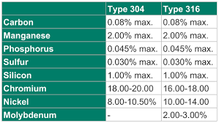
Steel composition
Stainlesssteels are steels containing around less than 1.2% carbon ,10.5% chromium and other Alloys.
Stainless steel's corrosion resistance and mechanical properties can even be enhanced by adding other elements, such as nickel,titanium, niobium, molybdenum, manganese, etc.

Slide 8
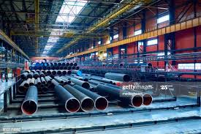
steel Manufacturing
A scuba tank’s capacity is determined by its size and pressure rating. Generally these containers have capacities ranging from 60 to 100 cf, with compressed air pressures ranging from low-pressure with 2500-2700 psi, standard pressure with 3000 psi, and high-pressure at 3300-3500 psi.
steel is usually the ideal choice, If you prefer a higher pressure tank.
if moisture is introduced during the fill process Steel tanks may be damaged , because of oxidation reaction.

Slide 9
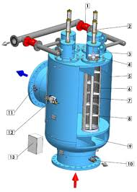
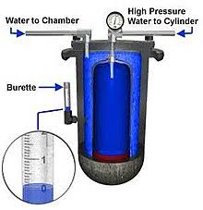
Diving cylinder sectional view

Slide 10
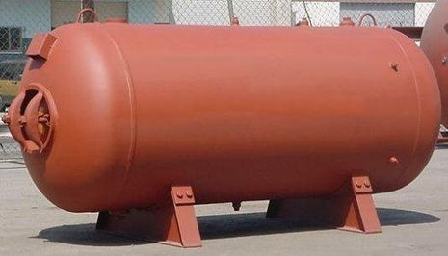
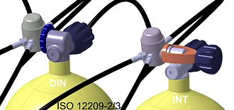
Material components
The functional diving cylinder consists of a pressure vessel and a cylinder valve. There are usually one or more optional accessories depending on the specific application.
Pressure Valve
1The pressure vessel is a seamless cylinder normally made of cold-extruded aluminium or forged steel.
Cylindrical valve
2 The purpose of the cylinder valve is to control gas flow to and from the pressure vessel and to provide a connection with the regulator or filling hose.

Slide 11
Creating cylinders
Creating a scuba cylinder is no minor feat, and it requires a great deal of pressure.
Steel cylinders are manufactured from a process named as deep draw, whereas aluminum cylinders are manufactured from the process commonly called backward extrusion.
as the material is put along a series of punches and dies, then we get a shell which seems like a large boul. In both processes, heat is applied to the top of the cylinder to draw a narrow opening.
PST, which has been manufacturing scuba cylinders from a very long time around since 1951, uses a very hot dip galvanizing process to apply a protective coating on their diving cylinders.

Slide 12

Manufacturing cylindrical valves
this valve is an very integral component of the cylinder.
One feature common to all cylinder valves is a pressure relief device (PRD), also known as a burst disk.
This tiny, frangible disk is designed to break and release the pressure within the cylinder when it reaches a critical pressure .
This can happen as a result of overfilling, or due to an increase in the temperature of the cylinder.

Slide 13
Tanking up
It’s important to get a good air fill.
The service pressure for the cylinder has a temperature of 70 F , due to which a accurately filled dive cylinder will show high pressure if temperature is high or low pressure if temperature is low.
Water can be easily flowed into thcylinder during the filling process, Corossion and Air quality problems are faced due to this easily. This fill should be done slowly for better results. Usually a fill rate of 300-600 psi per minute is recomended to prevent excessive heating during the fill.

Slide 14

Temperature change during filling (1/2)
Temperature rise is usually seen because of compression of gas, proportional to the pressure increase. Ambient air is compressed in steps, and the gas temperature rises during each step. Intercoolers and water cooling heat exchangers are used to remove this heat between stages.
filling an empty diving cylinder also causes a temperature rise as the gas inside the cylinder is highly compressed by the incursion of high pressure gas.
Excess heat can be removed by immersing the cylinder in a cold water bath

Slide 15
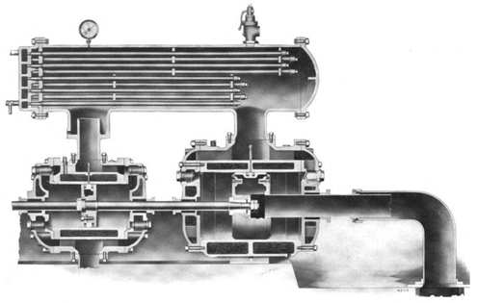
Temperature change during filling (2/2)
An intercooler is a mechanical device used to cool a gas after compression.
This process of filling the cylinders can be done without water-bath cooling , and may be charged to above the nominal working pressure to the developed pressure appropriate to the temperature when filled.
As the gas cools to ambient temperature, the pressure decreases suddenly , and usually reaches rated charging pressure at the rated temperature.

Slide 16
references
https://en.wikipedia.org/wiki/Diving_cylinder
https://www.aperam.com/stainless/what-is-stainless-steel/#:~:text=Stainless%20steels%20are%20steels%20containing,%2C%20niobium%2C%20manganese%2C%20etc.
https://en.wikipedia.org/wiki/Intercooler
https://dtmag.com/thelibrary/inside-look-at-scuba-cylinders/#:~:text=Creating%20Cylinders&text=Steel%20cylinders%20are%20made%20using,resembles%20a%20large%20coffee%20cup.
https://en.wikipedia.org/wiki/Stainless_steel
https://marineops.sfsu.edu/sites/default/files/History%20of%20Scuba%20Diving%20-%20Google%20Docs.pdf
https://prezi.com/sqzeacsoduhh/history-of-scuba-tanks/?frame=8edd4019315705fd46a8abf79441573e8d0cc94d

